Slide 1
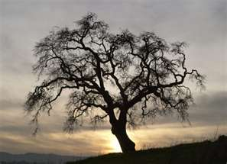
Trees for the Science Classroom

Slide 2
Common Trees of Pennsylvania
(Available from PA State Legislator)
Important Leaf terms:
Simple leaf (one piece)- maple, oak
Compound leaf {has leaflets with one petiole(stem)} - buckeye, white ash
Attachments on stem:
Alternate- leaves are not same height across the stem
Opposite- both sides same height across the stem
Deciduous- leaves lost in the fall
Evergreen- some leaves remain green on tree year- round.
Needle- like leaves (pine, spruce)
Scale-like leaves- (red, white cedar)

Slide 3
Main Parts of a Tree
Leaves are important for Photosynthesis.
Bell Ringer: When a tiny acorn grows into a huge oak tree with a mass of several tons, from where does the tree’s increase in mass come?
Roots- Absorb water and minerals; provide anchorage.
The Trunk provides support, protection, has a growing layer (cambium).
Reproductive structures may include berries, nuts, flowers, cones, catkins, winged seeds, etc.

Slide 4
Leaves for Collection
In Common Trees of PA
( ) Page in Tree Booklet
Eastern Hemlock- Official state tree of PA , has short, flat needles, is being decimated by the woolly agelgid (1) (evergreen)
Eastern Red Cedar- used for chests , has thinner, braided needles and blue berries (2) (evergreen)
Scots Pine- 2 short needles per cluster (6) and cones (evergreen)
Eastern White Pine- 5 long needles per cluster (10) and cones (evergreen)
Flowering Dogwood- curvy veins, red in autumn, has white, red, or pink bracts (look like flowers) in spring (12)
Norway Maple- has 5 lobes, winged fruits (14)
Silver Maple- 5 deep, coarsely toothed lobes (16)
White Ash- compound, 5-9 leaflets (20)
Magnolia- has a large seed pod (23)
Red Bud- Heart-shaped leaf, has a 3” seed pod, rose colored flowers in spring (25)

Slide 5
Leaves for Collection
In Common Trees of PA
( ) Pages in Tree Booklet
Paper birch- leaves oval with point, has catkin, back peels (30)
American Linden- heart shaped, uneven leaf, has “peas” (40)
Black Oak- taller than wide, 5-7 pointed lobes, acorns (42)
Pin Oak- 5-7 narrow lobes, acorns (44)
Sycamore- leaf wider than long, has buttonball fruits, multicolored, peeling bark (49)
Common Honey Locust- Alternate, compound small leaflets, large leathery, brown pod (54)

Slide 6
Other Trees/Shrubs for collection
Holly- small, pointed, waxy leaves, red berries (evergreen)
Bald Cypress- flat, soft needles, loses them in winter
Bamboo- long, narrow leaves, is an invasive species
White Cedar- “tree of life,” has flat, braided needles and cones (evergreen)
Yew- is a shrub or narrow tree, has soft green needles and gummy red (POISON) berries (evergreen)
Rhododendron- a shrub or small tree with waxy oval leaves and large lavender and other color flowers in spring
Red Spruce- has 1 “, prickly needles and cones (evergreen)
Fraser Fir- popular Christmas tree, has short needles pointing towards one side.

Slide 7
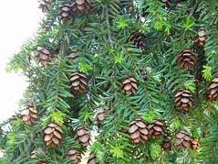
Hemlock

Slide 8
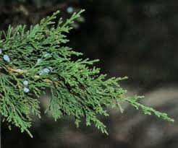
Red Cedar

Slide 9
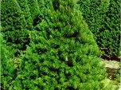
Scots Pine

Slide 10
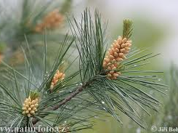
White Pine

Slide 11
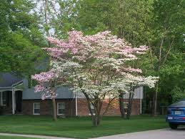
Dogwood

Slide 12
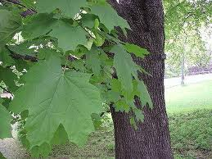
Norway Maple

Slide 13
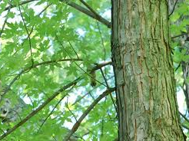
Silver Maple

Slide 14
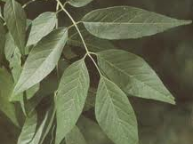
White Ash

Slide 15
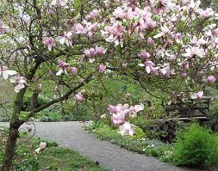
Magnolia

Slide 16
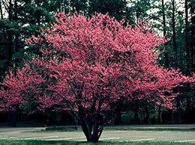
Red Bud

Slide 17
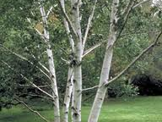
Paper Birch

Slide 18
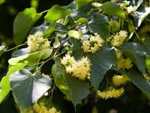
Linden

Slide 19
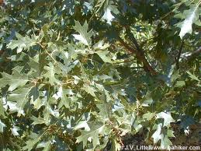
Black Oak

Slide 20
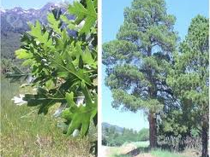
Pin Oak

Slide 21
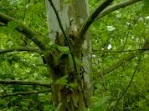
Sycamore

Slide 22
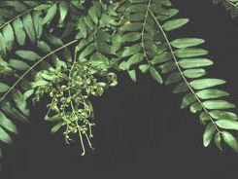
Honey Locust

Slide 23
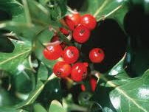
Holly

Slide 24
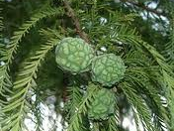
Bald Cypress

Slide 25
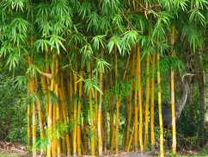
Bamboo

Slide 26
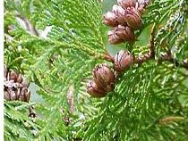
White Cedar

Slide 27
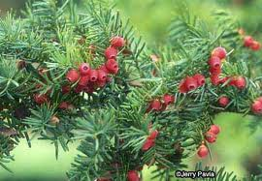
Yew

Slide 28
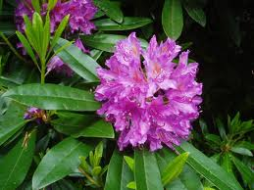
Rhododendron

Slide 29
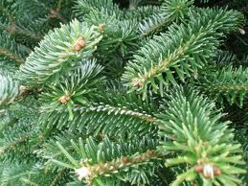
Fraser Fir

