Slide 1
Common Summer Wildflowers
Taxonomic Key Activity
Ed 370

Slide 2
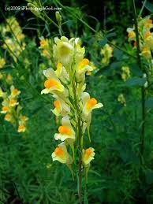
1. Butter and Eggs

Slide 3
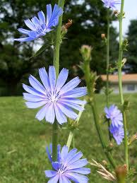
2. Chicory

Slide 4
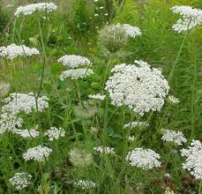
3. Queen Anne’s Lace

Slide 5
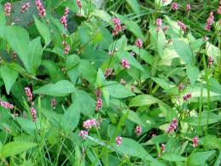
4. Smartweed

Slide 6
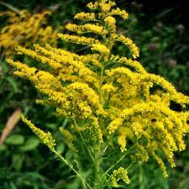
5. Goldenrod

Slide 7
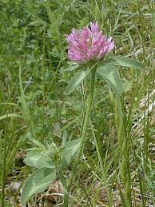
6. Red Clover

Slide 8
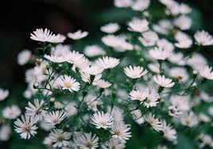
7. Aster (white)

Slide 9
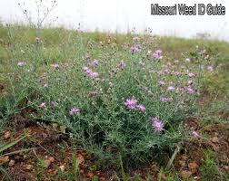
8. Knapweed

Slide 10
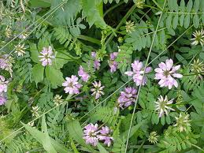
9. Crown Vetch

Slide 11
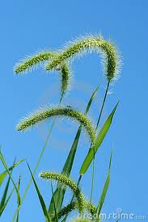
10. Foxtail Grass

Slide 12
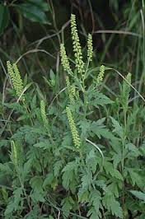
11. Ragweed

Slide 13
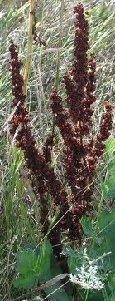
12. Dock (fall, dried)

Slide 14
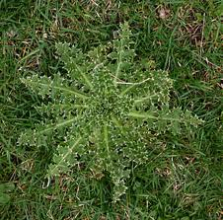
13. Thistle (leaves)

Slide 15
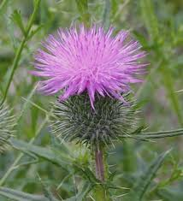
Thistle (flower)

Slide 16
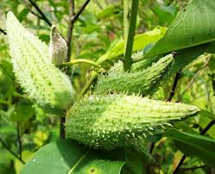
14. Milkweed (pod)

Slide 17
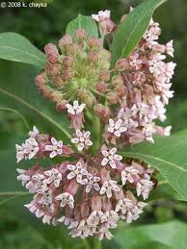
Milkweed Flower

Slide 18
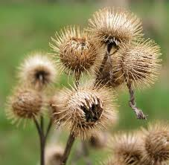
15. Burdock (burrs)

Slide 19
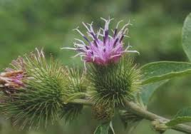
Burdock (Flowers)

Slide 20
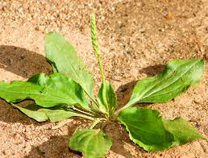
15. Common Plantain

Slide 21
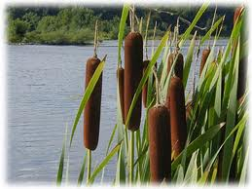
16. Cattail

