Slide 1
Common Spring Wildflowers of Pennsylvania
Wilkes
Science in Motion

Slide 2
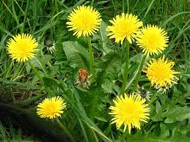
Common Dandelion
Taraxacum officinale

Slide 3
Common Dandelion Information
The common dandelion is a perennial, herbaceous plant with long, lance-shaped leaves that are deeply toothed. The leaves are 3 to 12 inches long and grow from a basal rosette. It has yellow composite flowers that are 1-2 inches wide and grow individually on hollow, purplish stalks 2 to 18 inches tall. Each flower head is made up of hundreds of tiny rays. Familiar to most viewers is the white, globular “seed head”.

Slide 4
Dandelion continued
The dandelion has a thick, highly branched taproot. All parts of the plant contain a sticky, milky white sap.
Dandelions are generally easily recognizable in all seasons. The growth of leaves from the basal rosette, the leaf shape with its characteristic multi-toothed edges (although some dandelions exhibit less toothiness and a smoother, broader leaf – these are generally found in shady areas) is easy to spot even in winter. If unsure, break a stem or leaf and the characteristic milky sap will emerge. When in bloom, dandelions are bright yellow and hard to miss.

Slide 5
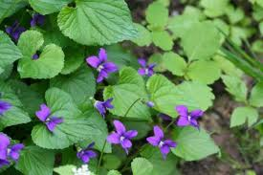
Marsh Blue Violet
Viola cucullata

Slide 6
Marsh Blue Violet
It is a common violet with lavender petals that are darker blue toward the throat. The hairs on the inside of the side petals are short and thick, not hair-like but swollen at the tip like small clubs (when viewed through a magnifying glass).
The flowers are on separate stalks from the leaves; flower stalks are longer than the leaf stalks. Leaves are heart-shaped, 1-2" (2.5-5 cm) wide, hairless, and broadly toothed.

Slide 7
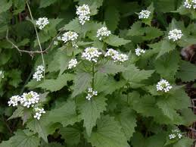
Garlic Mustard
Alliaria petiolata

Slide 8
Garlic Mustard
Garlic mustard is a hardy biennial of the mustard family, Brassicaceae. In its first year of life, the plant is characterized by a slender taproot and a rosette of dark green, kidney shaped leaves. The plant is low to the ground, about ½ to 2 inches tall. The leaves remain green all winter and when crushed, smell like garlic. Garlic mustard is therefore named after its family and smell. In its second year of life, garlic mustard grows to be 2-3 ½ feet tall and has toothed leaves.

Slide 9
Garlic Mustard
It also produces flowers sometime between late April and June. These flowers are small and white and their four petals form tiny crosses. The fruit of the plant is a slender pod called a silique. The silique contains two rows of black, oblong seeds which usually develop in May. Each plant contains hundreds of these seeds which are released from the pod in late June when it splits open.

Slide 10
Garlic Mustard (cont’d)
It is able to grow before most plants in the spring because it is a tenacious plant able to handle both cold and shade. It can grow in a great variety of environments: moist, shaded soil of river flood plains, forests, roadsides, edges of woods, and forest openings. It does very well in areas of disturbance. It is also considered to be an invasive species in some areas.

Slide 11
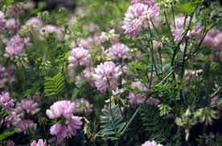
Crown Vetch

