Slide 1
Heredity and Genetics
Mendelian Human Genetic Traits

Slide 2


Tongue Rolling
T- tongue roller
  Dominant
  Tt or TT
t - non-roller
  Recessive
  tt

Slide 3
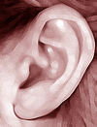
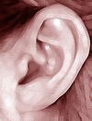
Attached Earlobes
E- Earlobes
  Dominant
  EE or Ee
e- no earlobes
  Recessive
  ee

Slide 4
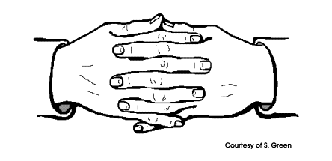
Interlocking Fingers
I- interlocking fingers (left thumb)
  Dominant
  II or Ii
i- interlocking fingers (right hand)
  Recessive
  ii

Slide 5
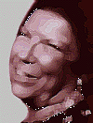

Dimples
D- Dimples
  Dominant
  DD or Dd
d- no dimples
  Recessive
  dd

Slide 6
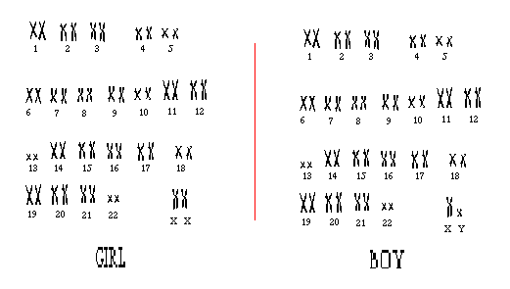
Sex
Male XY
Female XX

Slide 7

Bent Little Finger
L- Bent Little Finger
  Dominant
  LL or Ll
l- Non-bent Little Finger
  Recessive
  ll

Slide 8

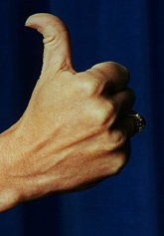
Hitchhiker Thumb
N- No Hitchhiker Thumb
  Dominant
  NN or Nn
n- Hitchhiker Thumb
  Recesive
  nn

Slide 9

Freckles
F- Freckles
  Dominant
  FF or Ff
f- no Freckles
  Recessive
  rr

Slide 10


Widow’s Peak
W- widows peak
  Dominant
  WW or Ww
w- no widow’s peak
  Recessive
  ww

Slide 11
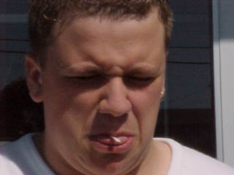
PTC Taste
(phenylthiocarbamide)
P- PTC Taster
  Dominant
  PP or Pp
p- non-Taster
  Recessive
  pp

Slide 12
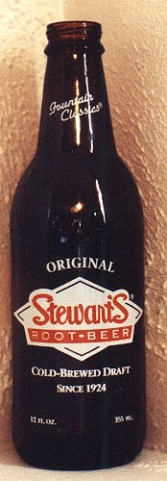
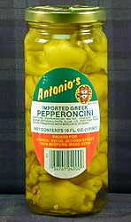
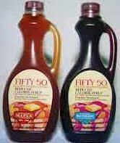
Sodium Benzoate Taste
S- Sodium Benzoate Taster
  Dominant
  SS or Ss
s- Sodium Benzoater Non-Taster
  Recessive
  ss

Slide 13
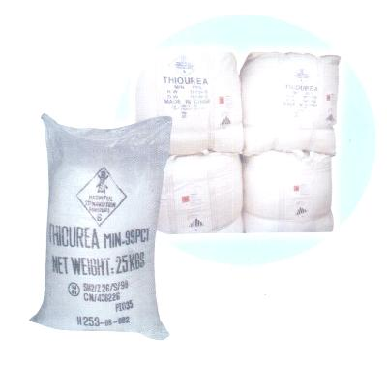
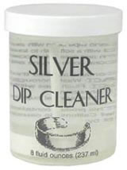
Thiourea Taste
T- Thiourea Taster
  Dominant
  TT or Tt
Thiourea Non-Taster
  Recessive
  Tt

